Slide 1

COMMUNICATION
Interpersonal Dynamics
Outcomes of Interpersonal Behaviors
What are the advantages of interpersonal relations?
  Can be a primary source of need satisfaction.
  Serve as a solid basis for social support.
  Can be a source of synergy.
  Employees who support each other work well together.

Slide 2
Definition of Communication
The process of transmitting information from one person to another.
What is effective communication?
  The process of sending a message in such a way that the message received is as close in meaning as possible to the message intended.
  Functions of Management That Communication Relates to
Planning
Organizing
Leading
Controlling

Slide 3
The Communication Process
Noise
Sender
Receiver
2
Encoding
3
Transmission
through Channels
4
Decoding
Noise
Start
1
Meaning
5
Meaning
7
Transmission
through channels
8
Decoding
6
Encoding
Receiver
Sender
Noise

Slide 4
Forms of Communication in Organizations
Oral communication
  Face to face conversations
  Group discussions
  Telephone calls
  Other situations in which the spoken word is used to express meaning
Written Communication
  Memos
  Letters
  Reports
  Notes
  Methods where by the written word is used

Slide 5
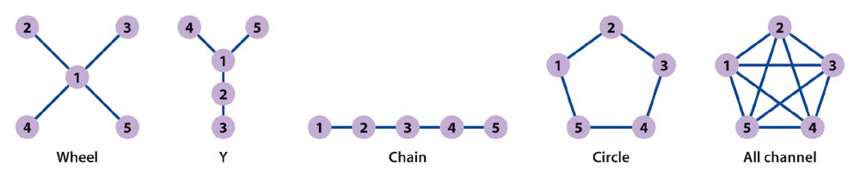
Types of Communication Networks

Slide 6
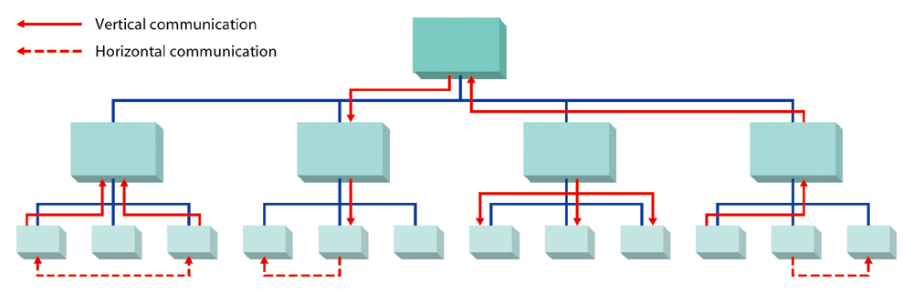
Figure 18.3: Formal Communication in Organizations

Slide 7
Vertical Communication
It flows up and down the organization.
How does it flow?
  Usually along formal lines.
Where does it take place?
  Between managers and their subordinates and may involve several different levels of the organization.
Horizontal Communication
Flows laterally within the organization.
Who is involved?
  Colleagues and peers at the same level of the organization and may involve individuals from several different organizational units.

Slide 8
Informal Communication in Organizations
The grapevine?
  An informal communication network that can permeate an entire organization.
Management by wandering around?
  An approach to communication that involves the manager literally wandering around and having spontaneous conversations with others who are involved with the company in some way.

Slide 9
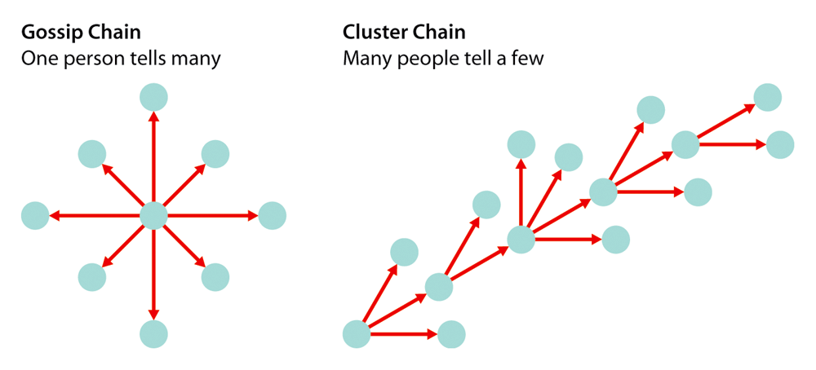
Common Grapevine Chains found in Organizations

Slide 10

Nonverbal Communication
Any communication exchange that does not use words or that uses words to carry more meaning than the strict definition of the words themselves.

Slide 11
Barriers to Communication
Individual Barriers:
  Conflicting or inconsistent cues.
  Credibility about the subject.
  Reluctance to communicate.
  Poor listening skills.
  Predispositions about the subject.
Organizational Barriers:
  Semantics.
  Status or power differences.
  Different perceptions.
  Noise.
  Overload.
(see Table 18.1 illustration)

Slide 12
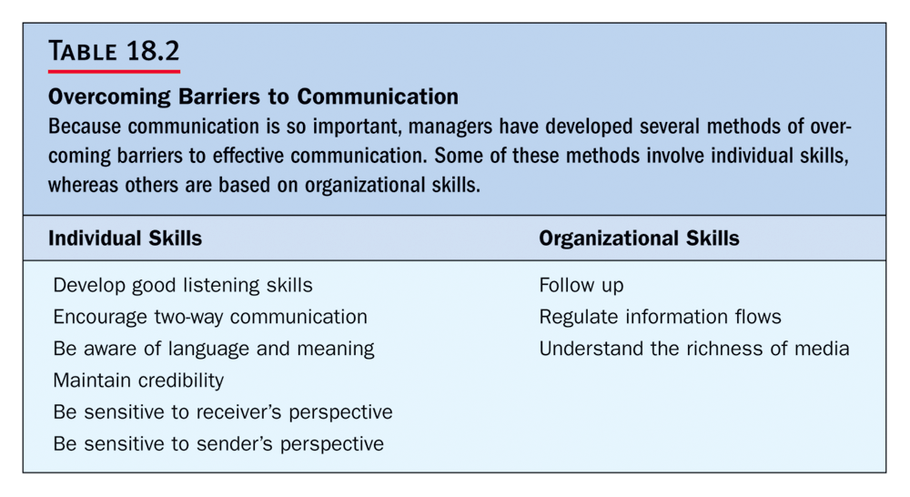
Insert Table 18.2

Slide 13
More and Less Effective Listening Skills
More Effective Listening
Less Effective Listening
Stays active, focused
Is passive, laid back
Pays attention
Is easily distracted
Asks questions
Asks no questions
Keeps an open mind
Has preconceptions
Assimilates information
Disregards information

